Slide 1
Inventory Management System for Hakuna Matata Roofing Materials
James Paul Abid
Carl John Ignacio V. Nicor

Slide 2
Project Context
Hakuna Matata Roofing Materials is a company that provides roofing materials like tiles and steel decks. They also offer construction planning, consultation, and installations. The company’s owner has relayed to us that they are having difficulties keeping track of records in Excel which is not an entirely dependable tool for record gathering since it requires a lot of manual input.

Slide 3
Project Goals and Objectives
Provide a system that is simple and will improve record tracking.
Reduce required manual input.

Slide 4
Chapter 2 Data Collection and Analysis

Slide 5
Business Rule
The Owner supervises the business operation, their employess, and transactions.
Employees will manage costumers and transactions.
The employees are in charge of managing the inventory, and delivery/order details.

Slide 6
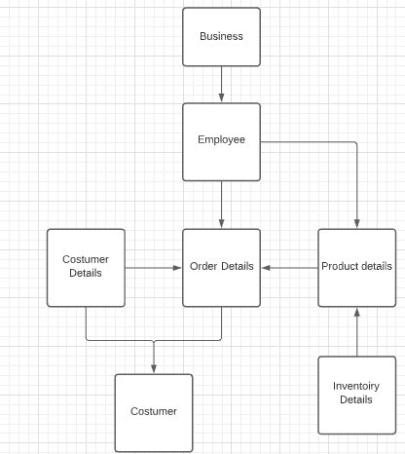
Data Model

Slide 7
Chapter 3 Database Design

Slide 8
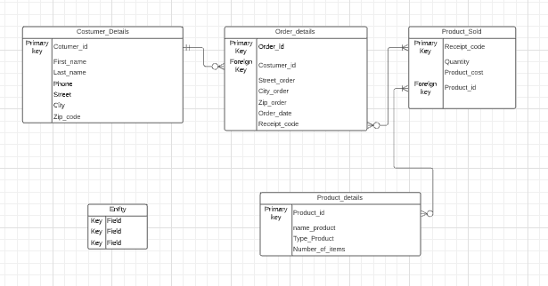
Crow’s Foot Model

Slide 9
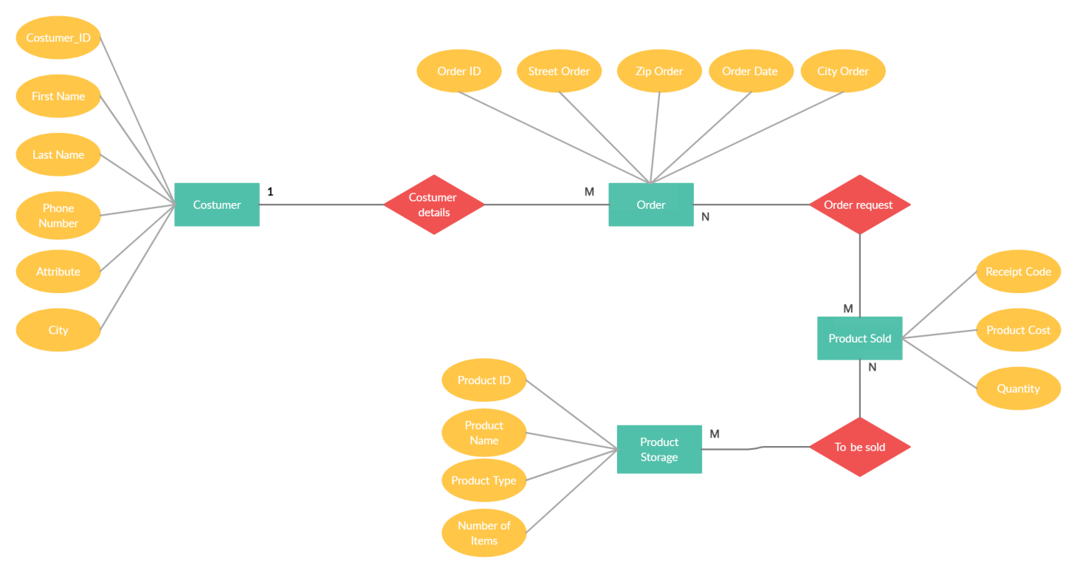
Chen diagram

Slide 10
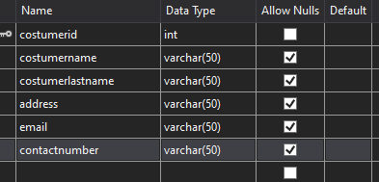
Data Dictionary –Metadata
Costumer

Slide 11
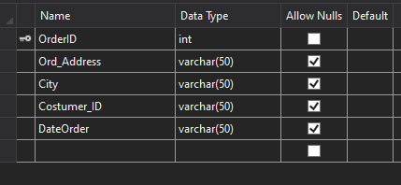
Order/Delivery

Slide 12
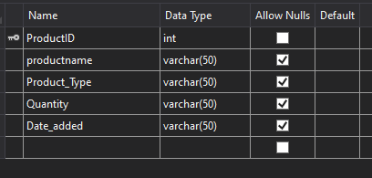
Product

Slide 13
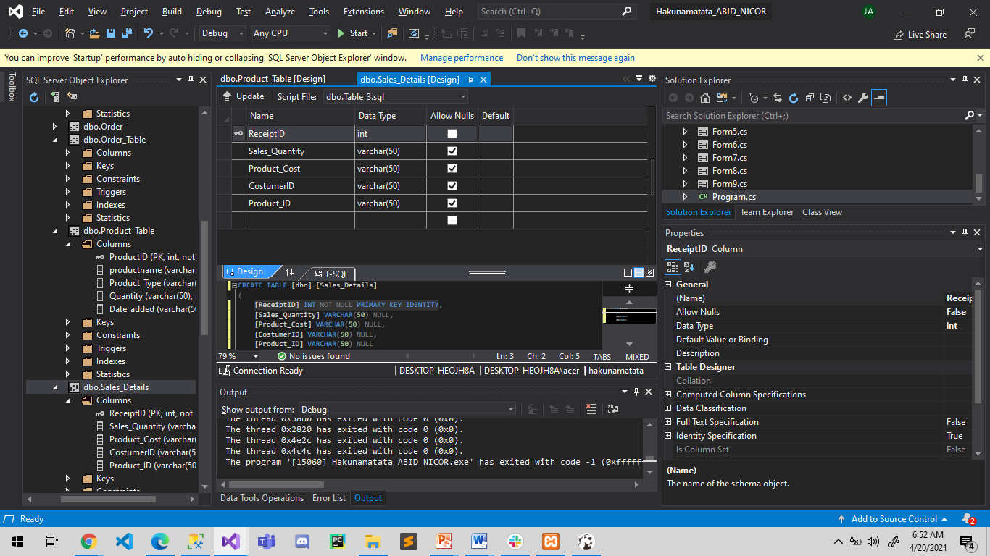
Sales

Slide 14
Prototype

Slide 15
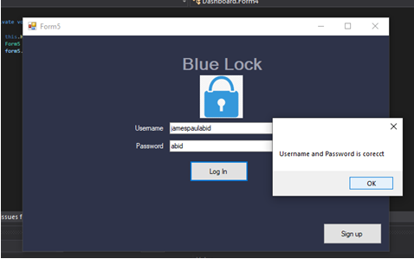

Slide 16
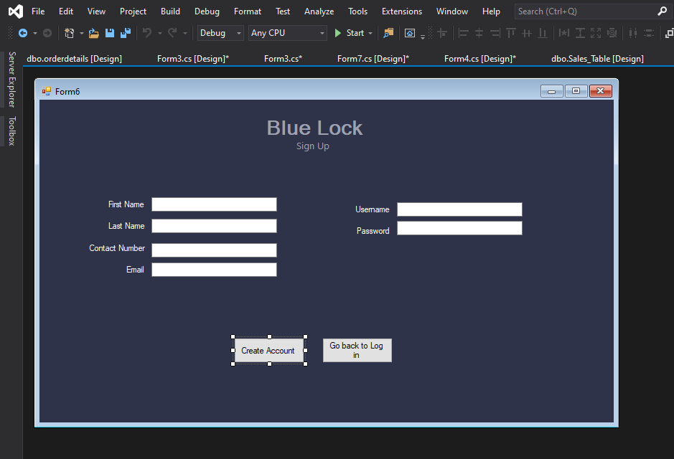

Slide 17
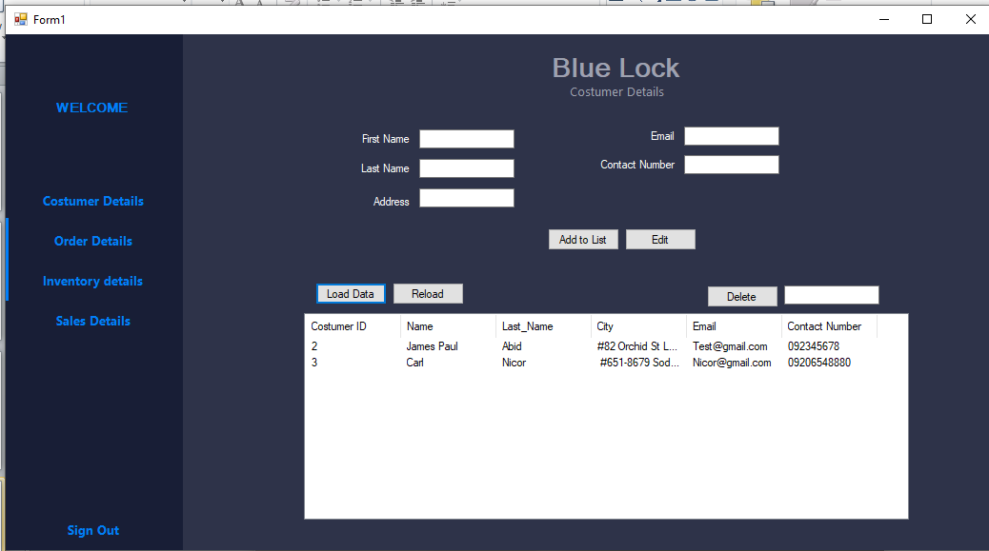

Slide 18
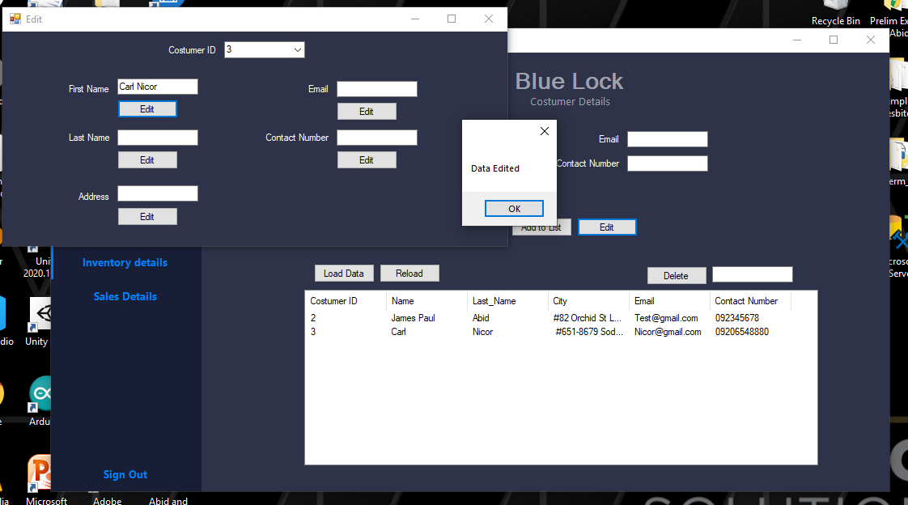

Slide 19
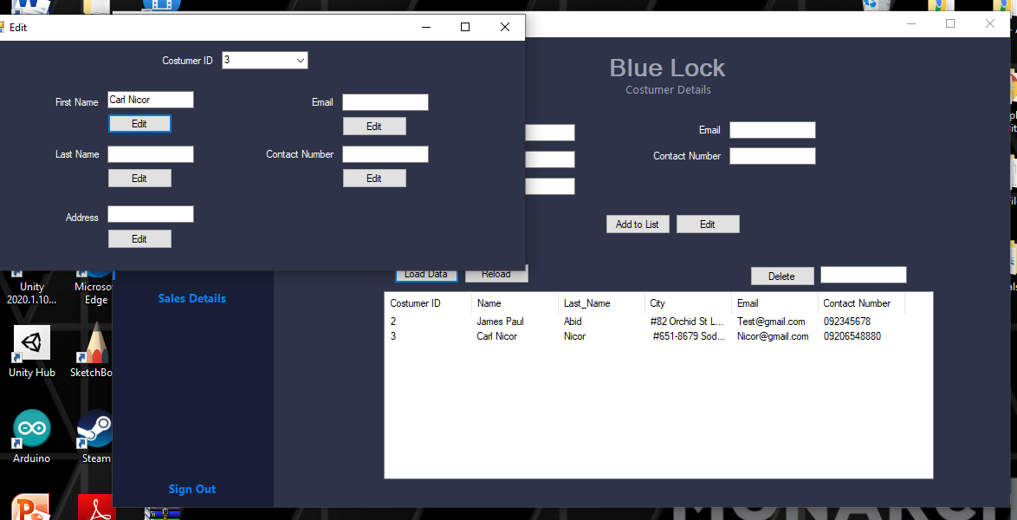

Slide 20
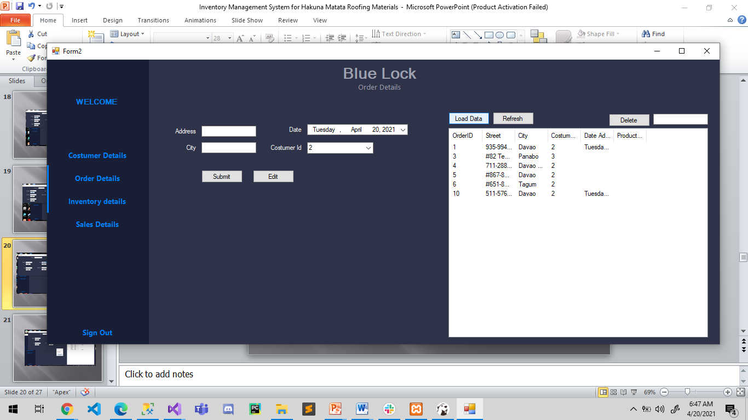

Slide 21
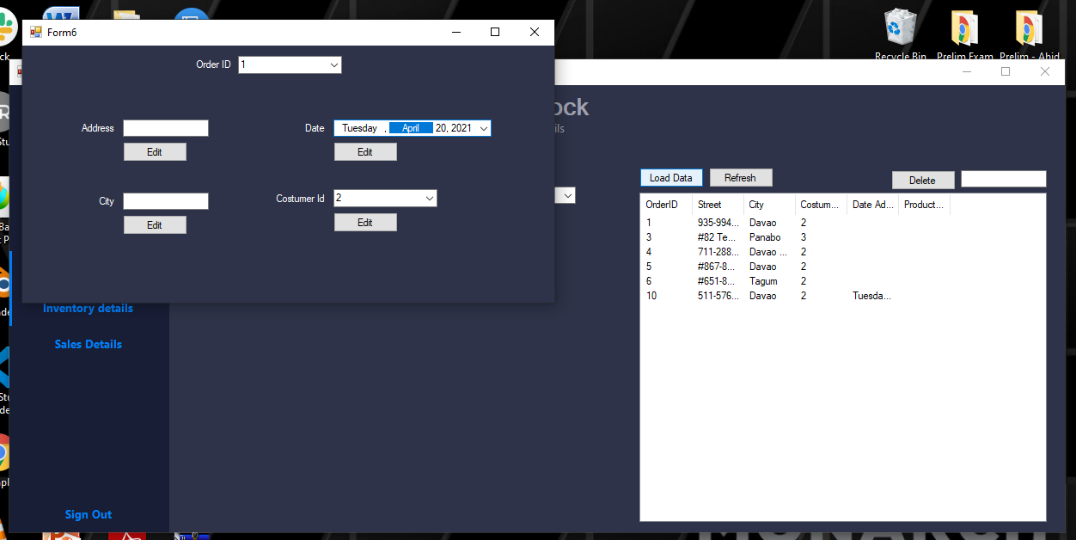

Slide 22
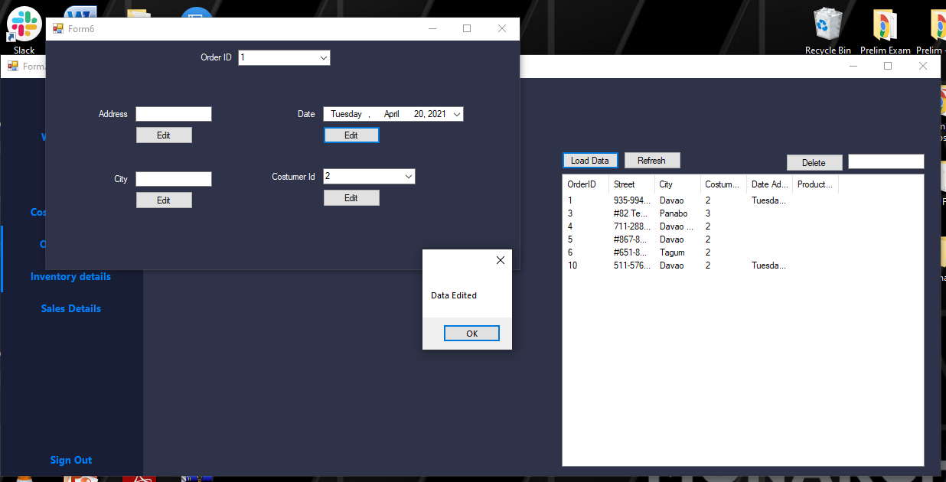

Slide 23
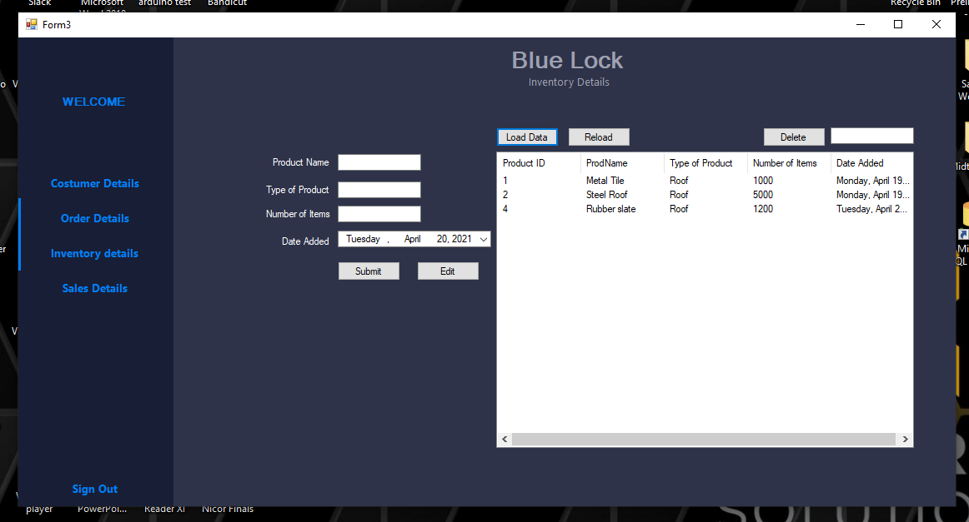

Slide 24
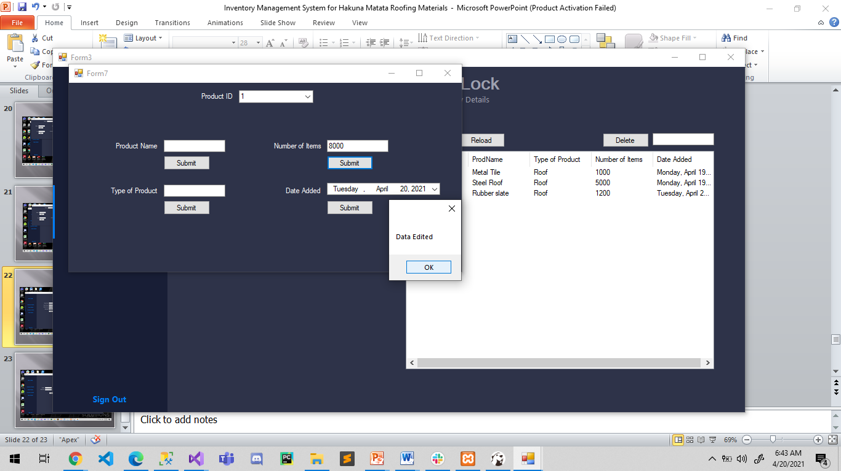

Slide 25
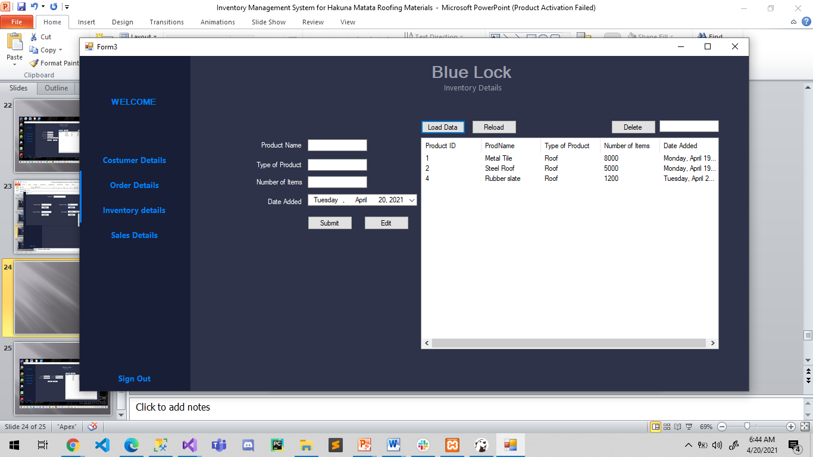

Slide 26
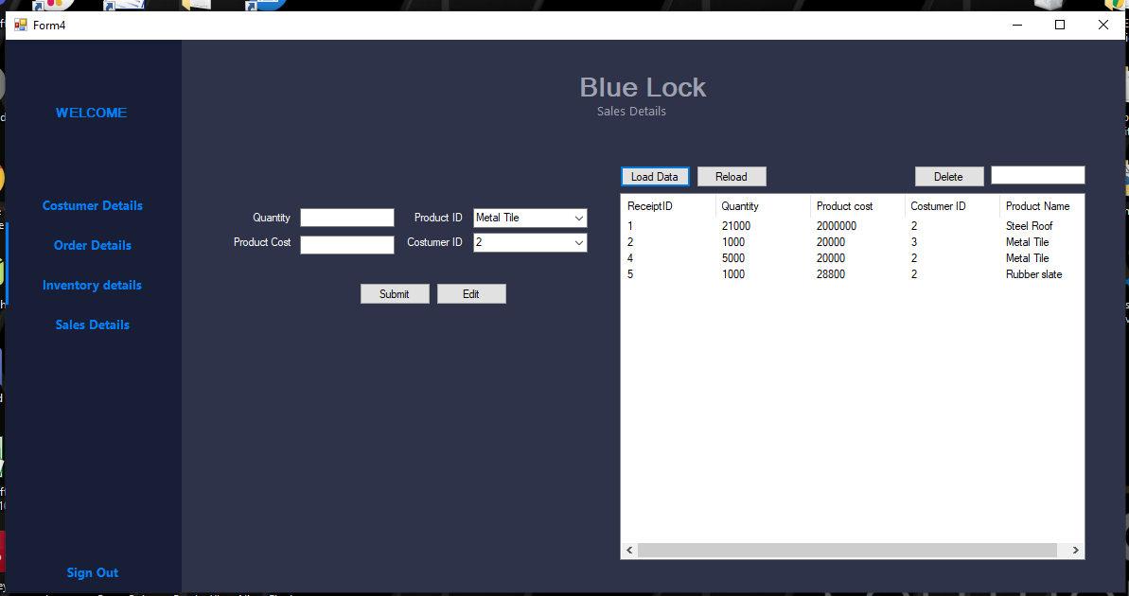

Slide 27
